Slide 1
MODULE III
Network layer design issues. Routing algorithms - The Optimality Principle, Shortest path routing, Flooding, Distance Vector Routing, Link State Routing, Multicast routing, Routing for mobile hosts. Congestion control algorithms. Quality of Service (QoS) - requirements, Techniques for achieving good QoS.

Slide 2
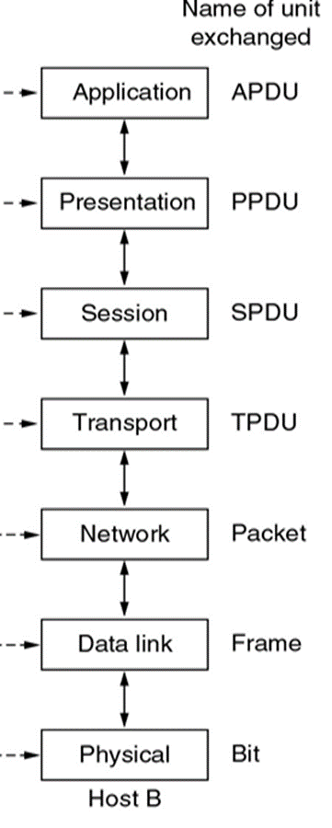
NETWORK LAYER
The network Layer controls the operation of the subnet.
The main aim of this layer is to deliver packets from source to destination across multiple links (networks).
If two computers (system) are connected on the same link, then there is no need for a network layer.
It routes the signal through different channels to the other end and acts as a network controller.
It also divides the outgoing messages into packets and to assemble incoming packets into messages for higher levels.
It must also take care when choosing routes to avoid overloading.

Slide 3
FUNCTIONS OF NETWORK LAYER
It translates logical network address into physical address.
Routers and gateways operate in the network layer.
Mechanism is provided by Network Layer for routing the packets to final destination.
Services are
flow control
error control and
packet sequence control.
Breaks larger packets into small packets.

Slide 4
Network Layer Design Issues
Store-and-forward packet switching
Services provided to transport layer
Implementation of connectionless service
Implementation of connection-oriented service
Comparison of virtual-circuit and datagram networks

Slide 5
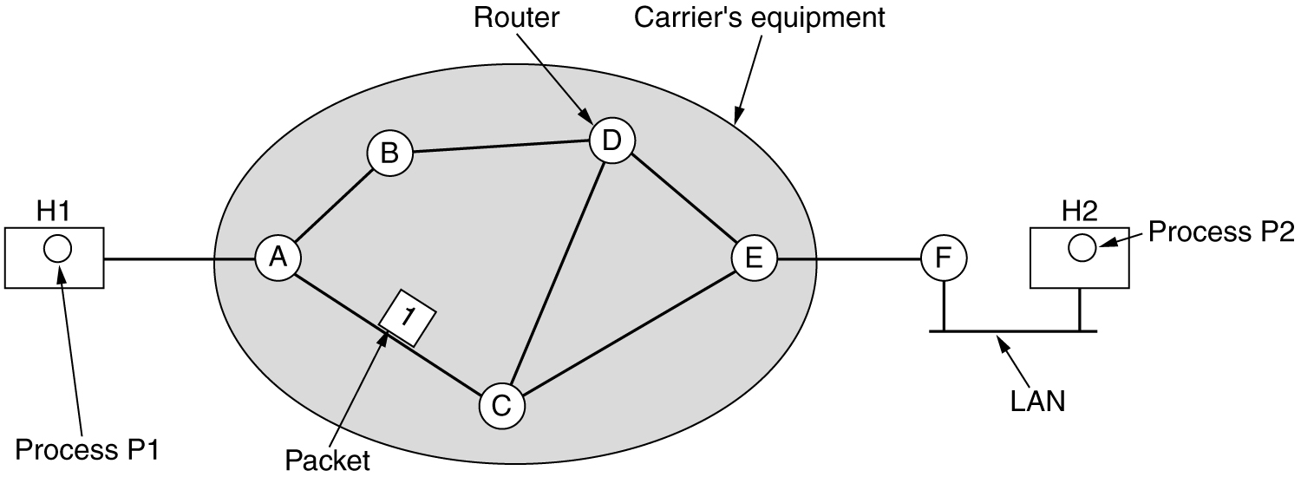
Store-and-Forward Packet Switching
The packet is stored there until it has fully arrived and the link has finished its processing by verifying the checksum.
Then it is forwarded to the next router along the path until it reaches the destination host, where it is delivered.
This mechanism is store-and-forward packet switching.

Slide 6
Services Provided To Transport Layer
The services provided should be independent of the underlying router technology.
The transport layer should be shielded from the number, type and different topologies of the subnets present.
Finally, there is a need for some uniform addressing scheme for network addresses across LANs and WANs.

Slide 7
Internal Organization of Network Layer
There are two different ways of organizing the subnet,
connectionless and
connection-oriented
In the context of the internal operation of the subnet, a connection is usually called a virtual circuit.
The independent packets of the connectionless organization are called datagrams.

Slide 8
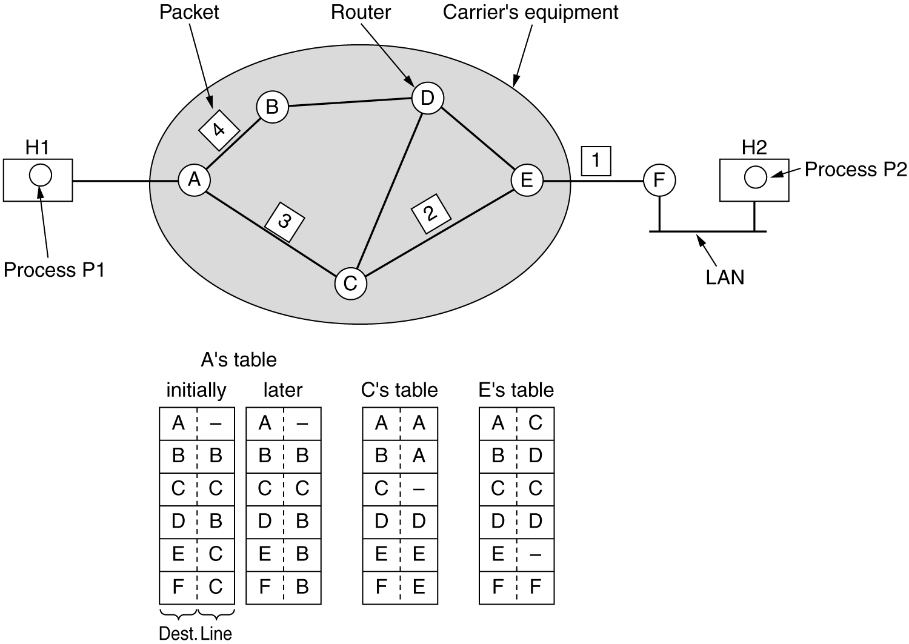
Implementation of Connectionless Service
Packets are injected into the network individually and routed independently of each other.
No advance setup is needed.
In this, the packets are frequently called datagrams and the subnet is called a datagram subnet.
Suppose that the process P1 has a long message for P2.
The message is four times longer than the maximum packet size, so the network layer has to break it into four packets, 1, 2,3,4.
Send each of them in turn to router A using some point-to-point protocol.
Routing within a datagram subnet

Slide 9
Implementation of Connectionless Service Conti..
Every router has an internal table telling (possible destinations).
Each table entry is a pair consisting of a destination and the outgoing line to use for that destination.
Only directly connected lines can be used.
A has only two outgoing lines—to B and to C
The algorithm that manages the tables and makes the routing decisions is called the routing algorithm.
Routing within a datagram subnet

Slide 10
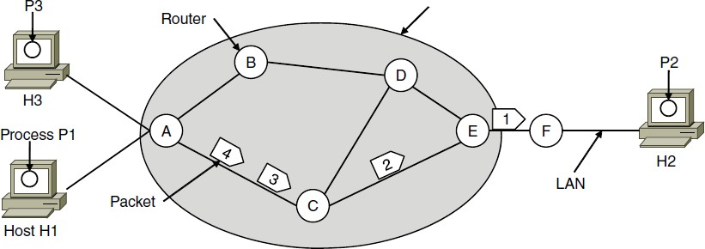

Implementation of Connection-Oriented Service
ISP’s equipment
A path from the source router to the destination router must be established before any data packets can be sent.
This connection is called a VC (virtual circuit), (eg. telephone system) and the subnet is called a virtual-circuit subnet.
The idea behind virtual circuits is
to avoid having to choose a new route for every packet sent.
A’s table
C’s Table
E’s Table
Routing within a virtual-circuit network

Slide 11
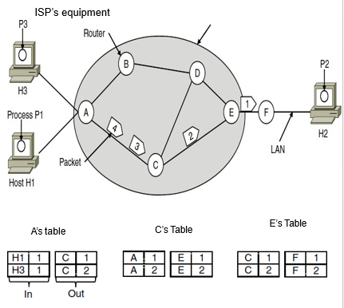
Implementation of Connection-Oriented Service
Here, host H1 has established connection 1 with host H2.
The first line of A's table says that
if a packet bearing connection identifier 1 comes in from H1,
it is to be sent to router C and given connection identifier 1.
Similarly, the first entry at C routes the packet to E, also with connection identifier 1.
Avoiding conflicts of this kind is why routers need the ability to replace connection identifiers in outgoing packets.
In some contexts, this is called label switching
Routing within a virtual-circuit network

Slide 12
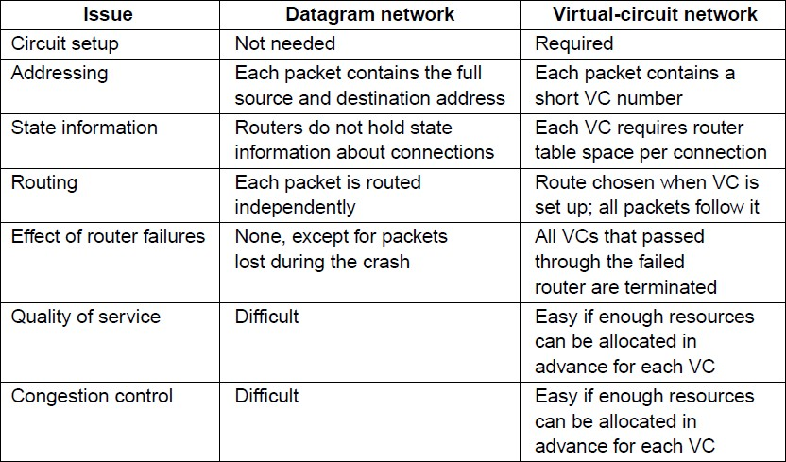
Comparison of Virtual-Circuit and Datagram Networks

Slide 13
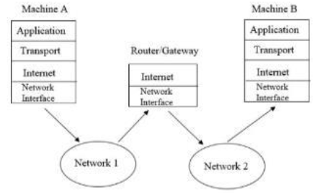
ROUTING
Routing is the process of moving packets across a network from one host to another.
It is usually performed by dedicated devices called routers.

Slide 14
Routing Algorithms
Routing algorithm is that part of the network layer software responsible for deciding which output line an incoming packet should be transmitted on.
If the subnet uses datagrams internally, this decision must be made anew for every arriving data packet since the best route may have changed since last time.
If the subnet uses virtual circuits internally, routing decisions are made only when a new virtual circuit is being set up.
Thereafter, data packets just follow the previously-established route.
This is sometimes called session routing because a route remains in force for an entire user session (e.g., a login session at a terminal or a file transfer).

Slide 15
Routing Algorithms
Distinction between routing & forwarding:
Routing is the process for making the decision which routes to use
responsible for filling in and updating the routing tables
Forwarding is what happens when a packet arrives
each packet looks up the routing tables for the outgoing line to use
Certain properties are desirable in a routing algorithm
correctness
simplicity
robustness
stability
fairness and
optimality

Slide 16
Routing Algorithms
Robustness
When network comes on the air, it may be expected to run continuously for years without system wide failures
Expected failures:
Hosts, routers, and lines will fail repeatedly
hardware and software failures
topology will change many times
Stability
A stable algorithm reaches equilibrium and stays there

Slide 17
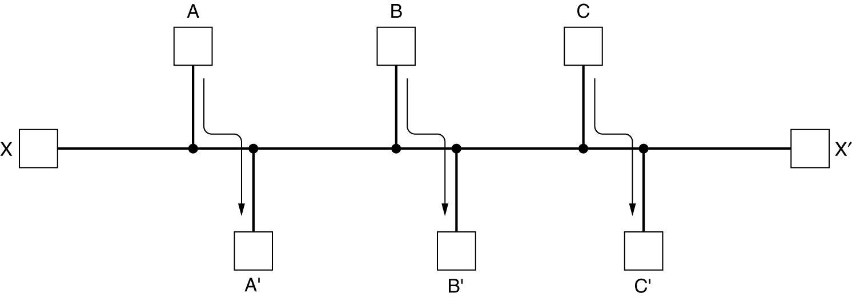
Routing Algorithms
Conflict between fairness (equality) and optimality (best possibility)
Suppose that there is enough traffic between A and A', between B and B', and between C and C' to saturate the horizontal links.
To maximize the total flow, the X to X' traffic should be shut off altogether.
Unfortunately, X and X' may not see it that way.

Slide 18
Routing Algorithms
Compromise
networks attempt to minimize the number of hops a packet must make
because reducing the number of hops tends to
reduces the delay
reduce the amount of bandwidth consumed
which improves the throughput

Slide 19
Routing Algorithms
Routing algorithms can be grouped into two major classes:
Nonadaptive
Adaptive
Non adaptive algorithms
Do not base their routing decisions on measurements or estimates of the current traffic and topology.
The choice of the route is computed in advance, off-line, and downloaded to the routers when the network is booted.
This procedure is sometimes called static routing.

Slide 20
Routing Algorithms
Adaptive algorithms
Routing decisions are based on measurements or estimates of the current traffic and topology.
Stability is an important goal for the routing algorithm.
This procedure is called dynamic routing.
differ in
where they get their information
(e.g., locally from adjacent routers, or from all routers)
when they change the routes
(e.g., every ΔT sec, when the load changes or when the topology changes)
what metric is used for optimization
(e.g., distance, number of hops, or estimated transit time)

Slide 21
Routing Algorithms
The Optimality Principle
Shortest Path Routing
Flooding
Distance Vector Routing
Link State Routing
Hierarchical Routing
Broadcast Routing
Multicast Routing
Routing for Mobile Hosts
Routing in Ad Hoc Networks

Slide 22
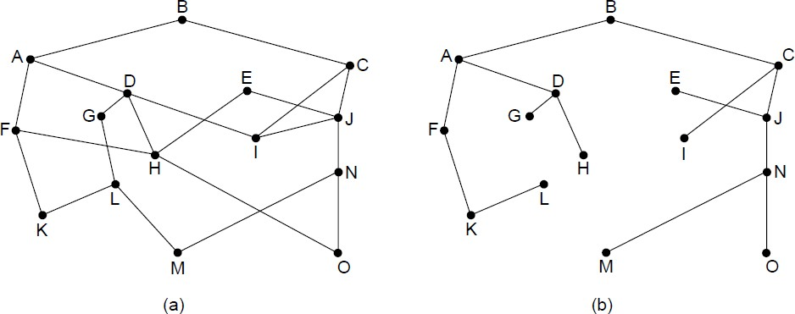
The Optimality Principle
The optimality principle states that if router J is on the optimal path from router I to router K, then the optimal path from J to K also falls along the same route.
The set of optimal routes from all sources to a given destination form a tree rooted at the destination.
Such a tree is called a sink tree.
The distance metric is the number of hops.
The goal of all routing algorithms is to discover and use the sink trees for all routers.
(a) A network. (b) A sink tree for router B.
Optimality Principle
If J is optimal path
from I to K
Then , optimal path
from J to K also same route

Slide 23
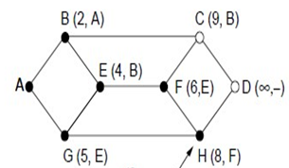
Shortest Path Algorithm
The idea is
build a graph of the subnet, with each node of the graph representing a router and each arc of the graph representing a communication line (often called a link).
To choose a route between a given pair of routers, the algorithm just finds the shortest path between them on the graph.

Slide 24
Shortest Path Algorithm
One way of measuring path length is the number of hops (A hop is the trip a data packet takes from one router to another in the network)or geographic distance in kilometers.
The labels on the arcs could be computed as a function of the distance, bandwidth, average traffic, communication cost, mean queue length, measured delay, and other factors.
Algorithms for computing the shortest path between two nodes of a graph:
Dijkstra’s shortest path

Slide 25
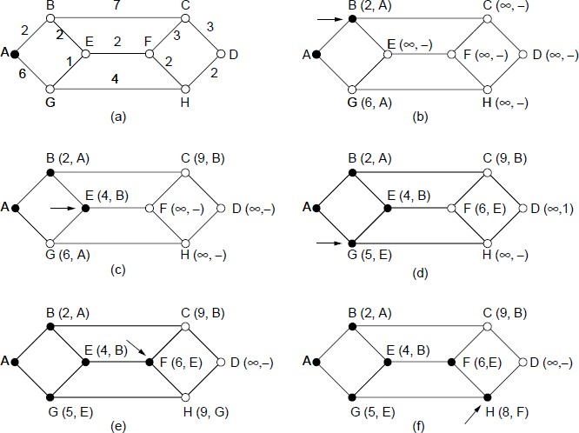
Dijkstra’s shortest path
ROUTER
COMMUNICATION LINE
1. Each node is labelled (in parentheses) with its distance from the source node along the best known path[eg. (2,A)].
2. Initially, no paths are known, so all nodes are labelled with infinity. As the algorithm proceeds and paths are found, the labels may change, reflecting better paths.
3. A label may be either tentative or permanent.
4. Initially, all labels are tentative.
5. When it is discovered that a label represents the shortest possible path from the source to that node, it is made permanent and never changed thereafter.
Fig: The first five steps used in computing the shortest path from A to D.
The arrows indicate the working node

Slide 27
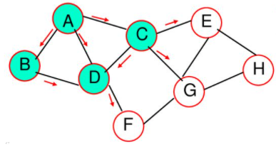
Flooding
Flooding is the static routing algorithm.
Every incoming packet is sent on all outgoing lines except the line on which it has arrived.
One major problem of this algorithm is that it generates a large number of duplicate packets on the network.
Several measures are takes to stop the duplication of packets.

Slide 28
Problem: generates a large number of duplicate packets
Solutions:
To include a hop counter in the header of each packet.
This counter is decremented at each hop along the path.
When this counter reaches zero the packet is discarded(reached at destination).
This requires the knowledge of exact number of hops from a source to destination.
2) The source router put a sequence number in each packet it receives from its hosts.
3)To use selective flooding , the routers do not send every incoming packet out on every output line. It will send only on those lines that are going approximately in the right direction.

Slide 29
Routing Algorithms
Flooding is not practical in most applications, but it does have some uses.
For example,
In military applications, where large numbers of routers may be blown to bits at any instant, the tremendous robustness of flooding is highly desirable.
In distributed database applications, it is sometimes necessary to update all the databases concurrently, in which case flooding can be useful.
In wireless networks, all messages transmitted by a station can be received by all other stations within its radio range.
Used in metric against which other routing algorithms can be compared.

Slide 30
Routing Algorithms
Advantages of Flooding:
always chooses the shortest path because it chooses every possible path in parallel.
Consequently, no other algorithm can produce a shorter delay (if we ignore the overhead generated by the flooding process itself).

Slide 31
Routing Algorithms
Distance Vector Routing
Modern computer networks generally use dynamic routing algorithms
because static algorithms do not take the current network load into account.
Two dynamic algorithms are the most popular
distance vector routing
link state routing

Slide 32
Routing Algorithms - DVR
Distance Vector Routing (DVR)
Algorithms operate by having each router maintain a table (i.e, a vector) giving the best known distance to each destination and which line to use to get there.
These tables are updated by exchanging information with the neighbors
Other names:
distributed Bellman-Ford routing algorithm
Ford-Fulkerson algorithm
original ARPANET routing algorithm
used in Internet under the name RIP (Routing Information Protocol)

Slide 33
Routing Algorithms - DVR
In DVR, each router maintains a routing table containing one entry for each router in the subnet.
This entry contains two parts:
the preferred outgoing line to use for that destination
an estimate of the time or distance to that destination
The metric used might be
number of hops,
time delay in milliseconds,
total number of packets queued along the path, or
something similar

Slide 34
Routing Algorithms - DVR
The router is assumed to know the ''distance'' to each of its neighbors.
If the metric is hops, the distance is just one hop.
If the metric is queue length, the router simply examines each queue.
If the metric is delay, the router can measure it directly with special ECHO packets that the receiver just timestamps and sends back as fast as it can.
Consider an example, assume that delay is used as a metric and that the router knows the delay to each of its neighbors.
Once every T msec, each router sends to each neighbor a list of its estimated delays to each destination.
It also receives a similar list from each neighbor.

Slide 35
Routing Algorithms - DVR
Let d_{x}(y) be the cost of the least-cost path from node x to node y. The least costs are related by Bellman-Ford equation,
d_{x}(y) = min_{v}{c(x,v) + d_{v}(y)}
Where the min_{v} is the equation taken for all x neighbors.
The least cost from x to y is the minimum of c(x,v)+d_{v}(y) taken over all neighbors.

Slide 36
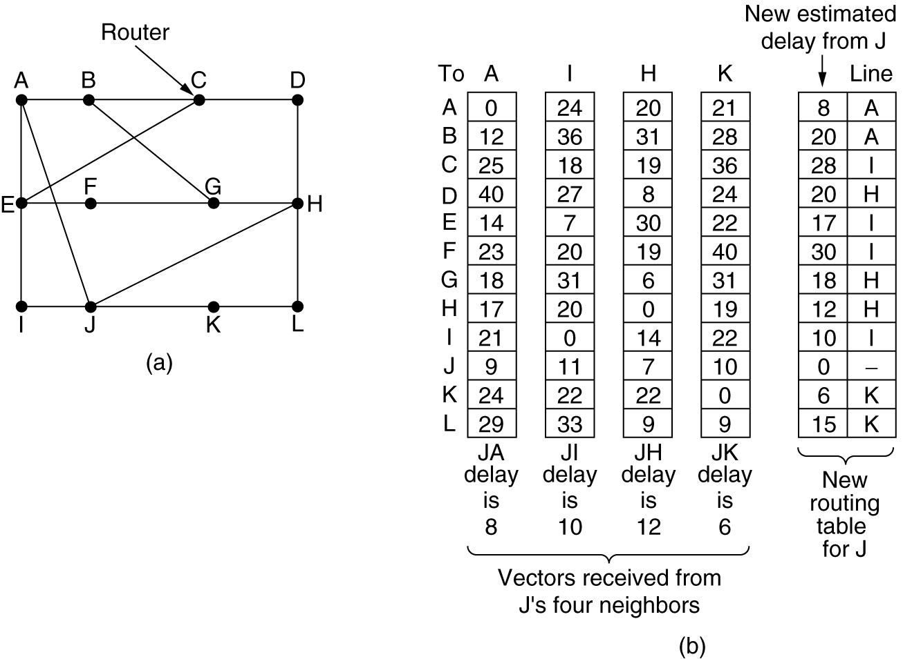
Distance Vector Routing
Source : J
Destination : G
(a) A subnet. (b) Input from A, I, H, K, and the new routing table for J.

Slide 37
Routing Algorithms - DVR
Suppose that J has measured or estimated its delay to its neighbors, A, I, H, and K as 8, 10, 12, and 6 msec, respectively
Consider how J computes its new route to router G.
It knows that it can get to A in 8 msec, and A claims to be able to get to G in 18 msec, so J knows it can count on a delay of 26 (8+18) msec to G if it forwards packets bound for G to A.
Similarly, it computes the delay to G via I, H, and K as 41 (31 + 10), 18 (6 + 12), and 37 (31 + 6) msec, respectively.
The best of these values is 18, so it makes an entry in its routing table that the delay to G is 18 msec and that the route to use is via H.
The same calculation is performed for all the other destinations, with the new routing table shown in the last column of the figure

Slide 38
DVR - Count to infinity problem
Distance vector routing works in theory but has a serious drawback in practice:
although it converges to the correct answer, it may do so slowly.
In particular, it reacts rapidly to good news, but leisurely to bad news.
Consider a router whose best route to destination X is large.
If on the next exchange neighbor A suddenly reports a short delay to X, the router just switches over to using the line to A to send traffic to X.
In one vector exchange, the good news is processed.

Slide 39
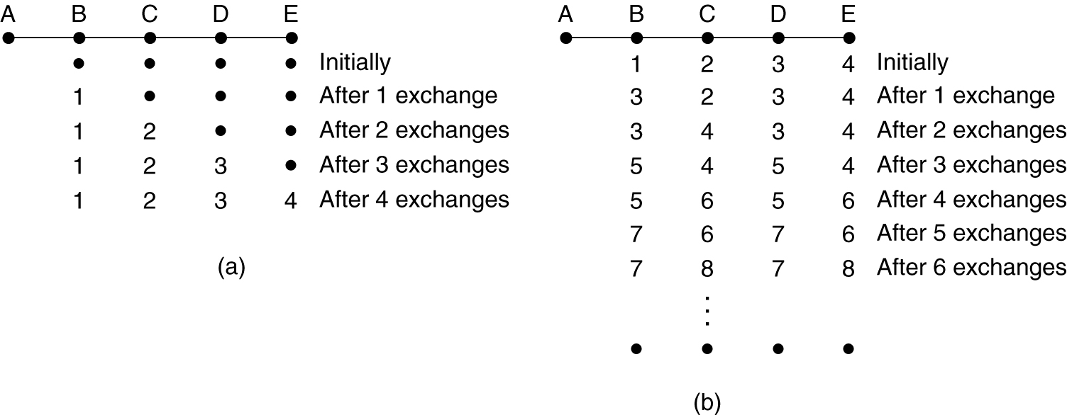
DVR- Count to infinity problem
a) Good news spreads faster

Slide 40
DVR- Count to infinity problem
To see how fast good news propagates, consider the five-node (linear) subnet of Fig. a, where the delay metric is the number of hops.
Suppose A is down initially and all the other routers know this.
In other words, they have all recorded the delay to A as infinity.
When A comes up, the other routers learn about it via the vector exchanges.
Assume periodically a vector exchange has initiated at all routers simultaneously.
At the time of the first exchange, B learns that its left neighbor has zero delay to A.
B now makes an entry in its routing table that A is one hop away to the left.
All the other routers still think that A is down.

Slide 41
DVR- Count to infinity problem
At this point, the routing table entries for A are as shown in the second row of Fig a.
On the next exchange, C learns that B has a path of length 1 to A
so it updates its routing table to indicate a path of length 2
but D and E do not hear the good news.
Clearly, the good news is spreading at the rate of one hop per exchange.
In a subnet whose longest path is of length N hops, within N exchanges everyone will know about newly-revived lines and routers

Slide 42
DVR- Count to infinity problem
b) The count-to-infinity problem.

Slide 43
DVR- Count to infinity problem
Now let us consider the situation of Fig. (b), in which all the lines and routers are initially up.
Routers B, C, D, and E have distances to A of 1, 2, 3, and 4, respectively.
Suddenly A goes down, or the line between A and B is cut
At the first packet exchange, B does not hear anything from A.
Fortunately, C says: I have a path to A of length 2.
B does not know that C's path runs through B itself.
As a result, B thinks it can reach A via C, with a path length of 3.
D and E do not update their entries for A on the first exchange.

Slide 44
DVR- Count to infinity problem
On the second exchange, C notices that each of its neighbors claims to have a path to A of length 3.
It picks one of the them at random and makes its new distance to A 4, as shown in the third row of Fig. (b).
why bad news travels slowly:
no router ever has a value more than one higher than the minimum of all its neighbors.
core of the problem is
when X tells Y that it has a path somewhere, Y has no way of knowing whether it itself is on the path.
Gradually, all the routers work their way up to infinity, but the number of exchanges required depends on the numerical value used for infinity.

Slide 45
Solutions for count to infinity problem
Set infinity to a limited number- the maximum number of hops to get across a certain network plus 1
Split horizon
When a node sends a routing update to its neighbors, it does not send those routes it learned from each neighbor back to that neighbor
For example, if B has the route (E, 2, A) in its table, then it knows it must have learned this route from A, and so whenever B sends a routing update to A, it does not include the route (E, 2) in that update
Split horizon with poison reverse
B actually sends that back route to A, but it puts negative information in the route to ensure that A will not eventually use B to get to E
For example, B sends the route (E, ∞) to A

Slide 46
Advantages of Distance Vector routing • It is simpler to configure and maintain than link state routing.
Drawbacks
React rapidly to good news when a router comes up.
Though it finally converges to correct result, it takes long time when where is a bad news.
There are several attempts to solve the problem, but none is perfect.
It does not take line bandwidth into account.
It took too long to converge.
It is slower to converge than link state.
It is at risk from the count-to-infinity problem.
It creates more traffic . Hop count updates take place on a periodic basis, even if there are no changes in the network topology, so bandwidth-wasting broadcasts still occur.
For larger networks, distance vector routing results in larger routing tables since each router must know about all other routers. This can lead to congestion on WAN links.

Slide 47
Tutorial
Consider the following subnet.
Distance vector routing is used, and the following vectors have just come in to router C: from B: (5, 0, 8, 12, 6, 2); from D: (16, 12, 6, 0, 9, 10); and from E: (7, 6, 3, 9, 0, 4). The measured delays to B, D, and E, are 6, 3, and 5, respectively. What is C's new routing table? Give both the outgoing line to use and the expected delay.

Slide 48
Routing Algorithms - LSR
Link State Routing (LSR)
Distance vector routing was used in the ARPANET until 1979
After that, it was replaced by link state routing
Two primary problems caused the failure of DVR.
Since the delay metric was queue length, it did not take line bandwidth into account when choosing routes.
Initially, all the lines were 56 kbps, so line bandwidth was not an issue, but after some lines had been upgraded to 230 kbps and others to 1.544 Mbps, not taking bandwidth into account was a major problem
Algorithm often took too long to converge (the count-to-infinity problem)
Variants of link state routing are now widely used.

Slide 49
Routing Algorithms - LSR
Idea behind LSR is simple and can be stated as 5 parts. Each router must do the following
Discover its neighbors & learn their network addresses.
Measure the delay or cost to each of its neighbors.
Construct a packet telling all it has just learned.
Send this packet to all other routers.
Compute the shortest path to every other router.

Slide 50
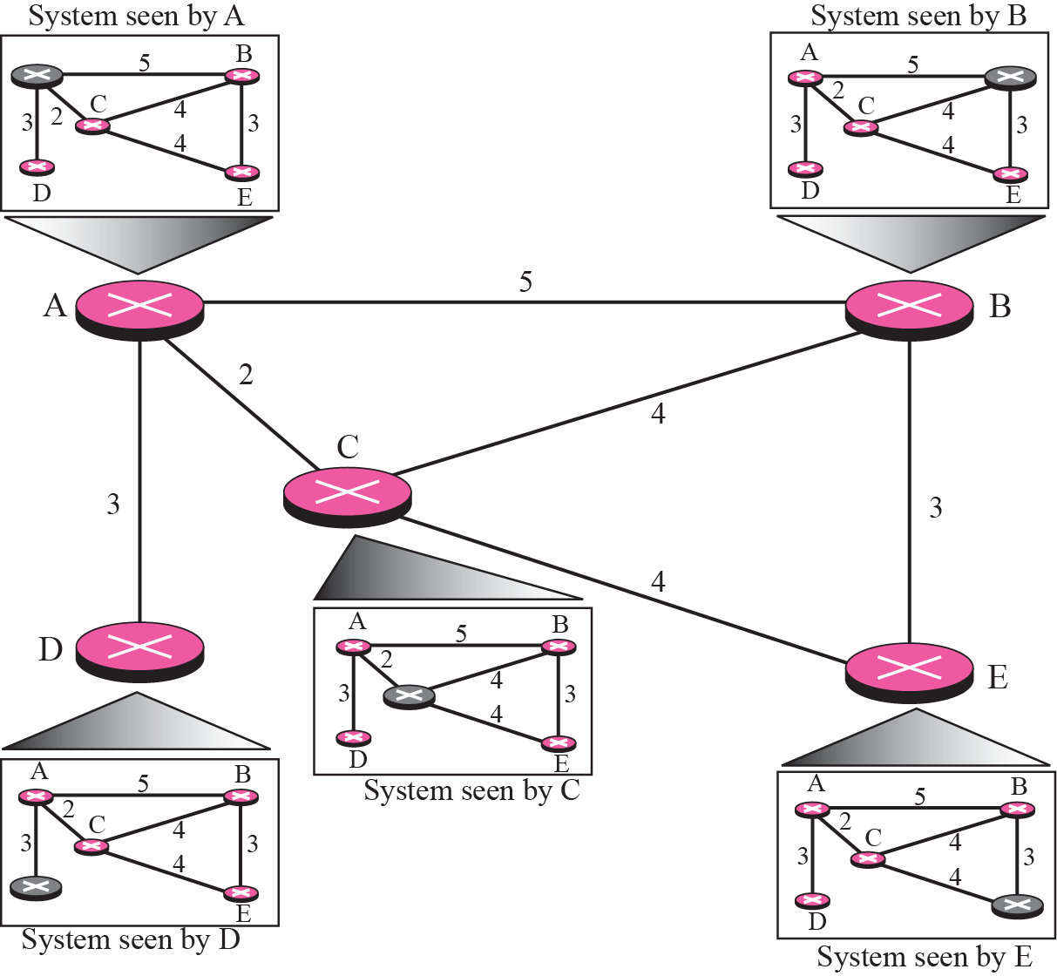
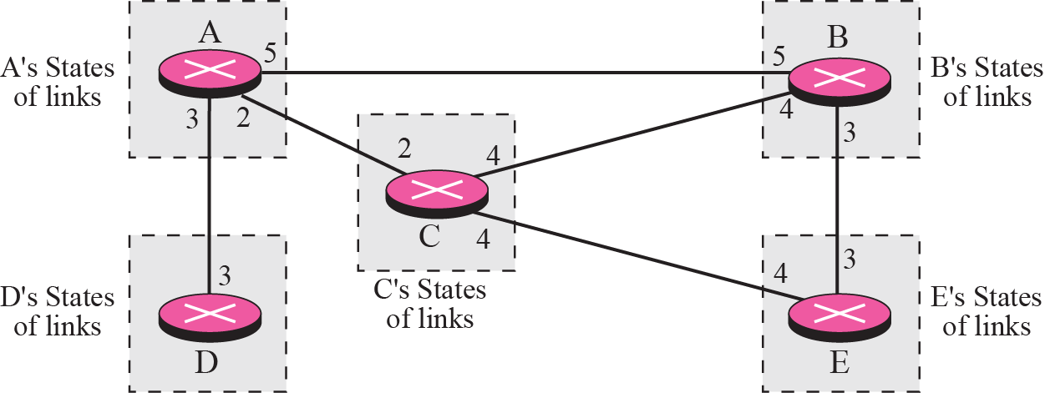
Fig: Link state knowledge
Discover its neighbors and learn their network addresses.
Set the distance or cost metric to each of its neighbors.
Construct a packet telling all it has just learned.
Send this packet to and receive packets from all other routers.
Compute the shortest path to every other router.( Dijkstra’s algorithm )
Fig: Concept of link state routing

Slide 51
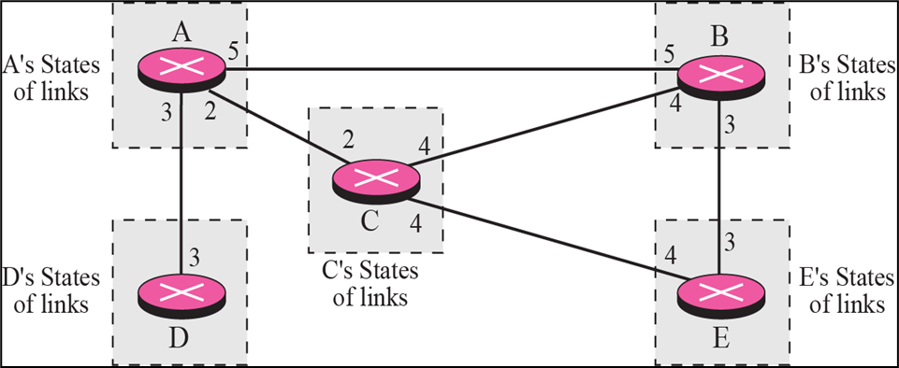
1.Learning about the neighbors
When a router is booted, its first task is to learn who its neighbors are.
It accomplishes this goal by sending a special HELLO packet on each point-to-point line.
The router on the other end is expected to send back a reply giving its name. These names must be globally unique.

Slide 52
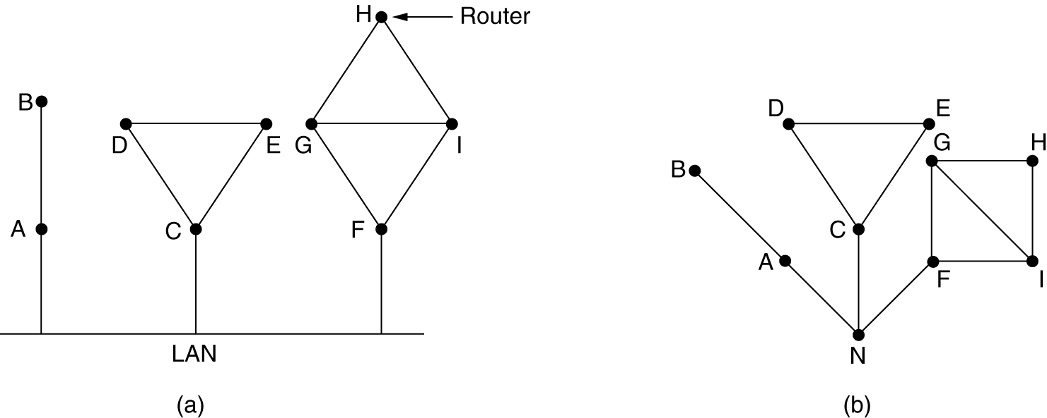
Routing Algorithms - LSR
When two or more routers are connected by a LAN, the situation is slightly more complicated
One way to model the LAN is to consider it as a node itself
(a) Nine routers and a LAN. (b) A graph model of (a).

Slide 53
2.Measuring Line Cost
Each router must know a reasonable estimate of the delay to each of its neighbors.
A special ECHO packet is sent over to neighbors that the other side is required to send back immediately.
By measuring the round-trip time and dividing it by two, the sending router can get a reasonable estimate of the delay.

Slide 54
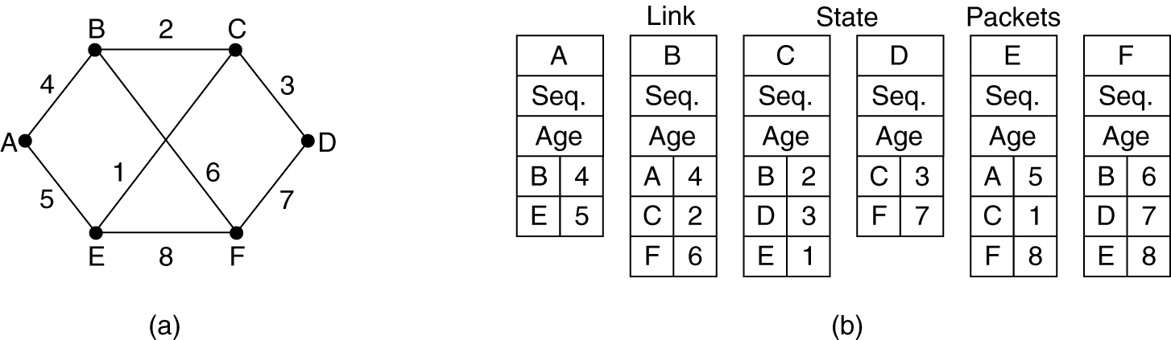
3.Building Link State Packets
The packet starts with the identity of the sender, followed by a sequence number and age, and a list of neighbours.
The link state packets are built either at regular intervals or when some significant event occurs
Once the information for the exchange has been collected, the next step is for each router to build a packet containing all the data.
(a) A subnet. (b) The link state packets for this subnet.

Slide 55
An example network is presented with costs shown as labels on the lines.
The corresponding link state packets for all six routers are shown.
Building the link state packets is easy.
The hard part is determining when to build them.
One possibility is to build them periodically, that is, at regular intervals.
(a) A subnet. (b) The link state packets for this subnet.

Slide 56
4.Distributing Link State Packets
Flooding is used to distribute the link state packets.
To keep the flood in check, each packet contains a sequence number that is incremented for each new packet sent.
Routers keep track of all the (source router, sequence) pairs they see.
When a new link state packet comes in, it is checked against the list of packets already seen.
If it is new, it is forwarded on all lines except the one it arrived on.
If it is a duplicate, it is discarded.
If a packet with a sequence number lower than the highest one seen so far ever arrives, it is rejected since the router has more recent data.

Slide 57
This algorithm has a few problems, but they are manageable
Problem 1: if the sequence numbers wrap around, confusion will happen.
solution is to use a 32-bit sequence number.
With one link state packet per second, it would take 137 years to wrap around, so this possibility can be ignored.
Problem 2: if a router ever crashes, it will lose track of its sequence number.
If it starts again at 0, the next packet will be rejected as a duplicate
Problem 3: if a sequence number is ever corrupted and 65,540 (1000 0000 0000 0100) is received instead of 4 (0000 0000 0000 0100) (a 1-bit error), packets 5 through 65,540 will be rejected as obsolete, since the current sequence number is thought to be 65,540.
Solution to all these problems is to include the age of each packet after the sequence number and decrement it once per second.
When the age hits zero, the information from that router is discarded.

Slide 58
5.Computing the New Routes
With all routers having full set of link state packets, it can construct the entire subnet graph.
It is run locally to construct shortest path to all possible destinations.
Dijkstra's algorithm can be run locally to construct the shortest path to all possible destinations.
The results of this algorithm can be installed in the routing tables, and normal operation resumed.
For a subnet with n routers, each of which has k neighbors, the memory required to store the input data is proportional to kn.

Slide 59
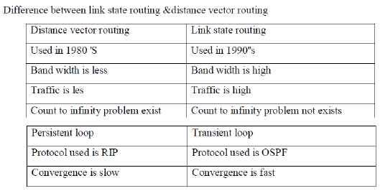

Slide 60
Multicast Routing
Multicasting- In multicast communication, there is one source and a group of destinations.
The relationship is one-to-many.
In this type of communication, the source address is a unicast address, but the destination address is a group address, which defines one or more destinations.
The group address identifies the members of the group.
Some applications require that widely-separated processes work together in groups, for example, a group of processes implementing a distributed database system.
In these situations, it is frequently necessary for one process to send a message to all the other members of the group.
Sending a message to such a group is called multicasting, and its routing algorithm is called multicast routing.

Slide 61
Multicasting requires group management. Some way is needed to create and destroy groups, and to allow processes to join and leave groups.
How these tasks are accomplished is not based on the routing algorithm. It is based on the fact that when a process joins a group, it informs its host of this fact. It is important that routers know which of their hosts belong to which groups.
Either hosts must inform their routers about changes in group membership, or routers must query their hosts periodically.
Either way, routers learn about which of their hosts are in which groups.
Routers tell their neighbors, so the information propagates through the subnet.

Slide 62
To do multicast routing, each router computes a spanning tree covering all other routers.
For example, in Fig.(a) we have two groups, 1 and 2. Some routers are attached to hosts that belong to one or both of these groups, as indicated in the figure. A spanning tree for the leftmost router is shown in Fig.(b).
Figure (a) A network. (b) A spanning tree for the leftmost router. (c) A multicast tree for group 1. (d) A multicast tree for group 2.

Slide 63
When a process sends a multicast packet to a group, the first router examines its spanning tree and prunes it, removing all lines that do not lead to hosts that are members of the group
In this example, Fig. (c) shows the pruned spanning tree for group 1.
Similarly, Fig. (d) shows the pruned spanning tree for group 2.
Multicast packets are forwarded only along the appropriate spanning tree.

Slide 64
Various ways of pruning the spanning tree are possible.
The simplest one can be used if link state routing is used and each router is aware of the complete topology, including which hosts belong to which groups. Then the spanning tree can be pruned, starting at the end of each path, working toward the root, and removing all routers that do not belong to the group in question.
With distance vector routing, a different pruning strategy can be followed. The basic algorithm is reverse path forwarding. However, whenever a router with no hosts interested in a particular group and no connections to other routers receives a multicast message for that group, it responds with a PRUNE message, telling the sender not to send it any more multicasts for that group. When a router with no group members among its own hosts has received such messages on all its lines, it, too, can respond with a PRUNE message. In this way, the subnet is recursively pruned.

Slide 65
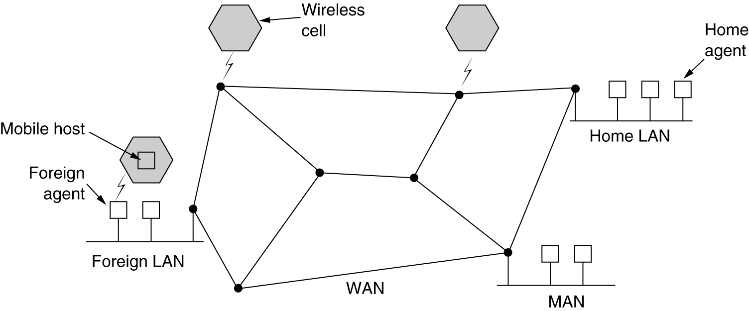
Routing Algorithms – Mobile Host
Routing for Mobile Hosts:
People have portable computers nowadays
Mobile hosts introduce a new complication:
to route a packet to a mobile host, network first has to find it.
Fig: A WAN to which LANs, MANs, and wireless cells are attached.

Slide 66
Routing Algorithms – Mobile Host
Hosts that never move are said to be stationary.
They are connected to the network by copper wires or fiber optics.
Migratory hosts are basically stationary hosts who move from one fixed site to another from time to time
but use the network only when they are physically connected to it.
Roaming hosts actually compute on the run and want to maintain their connections as they move around.
Mobile hosts are all hosts that are away from home and still want to be connected. (both Migratory hosts & Roaming hosts)

Slide 67
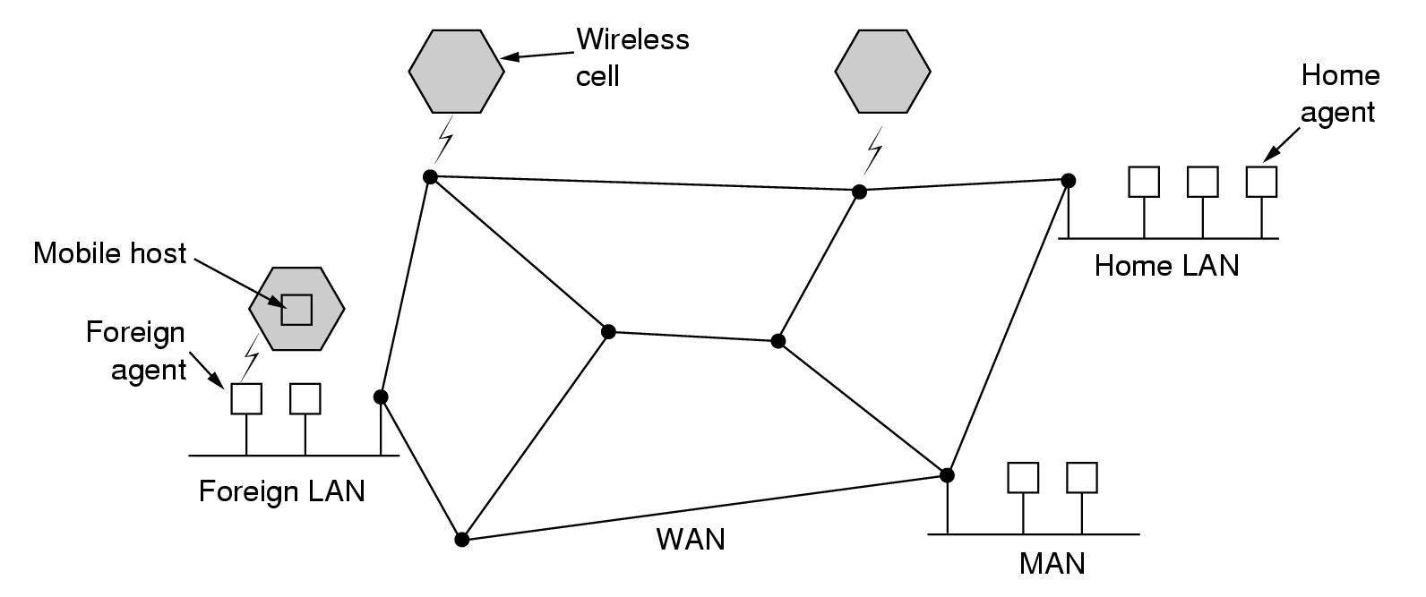
Fig: The model of the world that network designers typically use

Slide 68
Routing Algorithms – Mobile Host
In Fig., world is divided up (geographically) into small units, called as areas, where an area is typically a LAN or wireless cell.
Each area has one or more foreign agents, which are processes that keep track of all mobile hosts visiting the area.
Each area has a home agent, which keeps track of hosts whose home is in the area, but who are currently visiting another area.
When a new host enters an area, either by connecting to it (e.g., plugging into the LAN) or just wandering into the cell, it must register itself with the foreign agent.

Slide 69
Routing Algorithms – Mobile Host
The registration procedure typically works like this:
Step 1:
Periodically, each foreign agent broadcasts a packet announcing its existence and address.
A newly-arrived mobile host may wait for one of these messages,
But if none arrives quickly enough, the mobile host can broadcast a packet saying: Are there any foreign agents around?
Step 2:
The mobile host registers with the foreign agent, giving
its home address,
current data link layer address and
some security information.

Slide 70
Routing Algorithms – Mobile Host
Step 3:
The foreign agent contacts the mobile host's home agent and says: One of your hosts is over here.
The message from the foreign agent to the home agent contains the foreign agent's network address.
It also includes the security information to convince the home agent that the mobile host is really there
Step 4:
The home agent examines the security information, which contains a timestamp, to prove that it was generated within the past few seconds.
If it is ok, it tells the foreign agent to proceed.

Slide 71
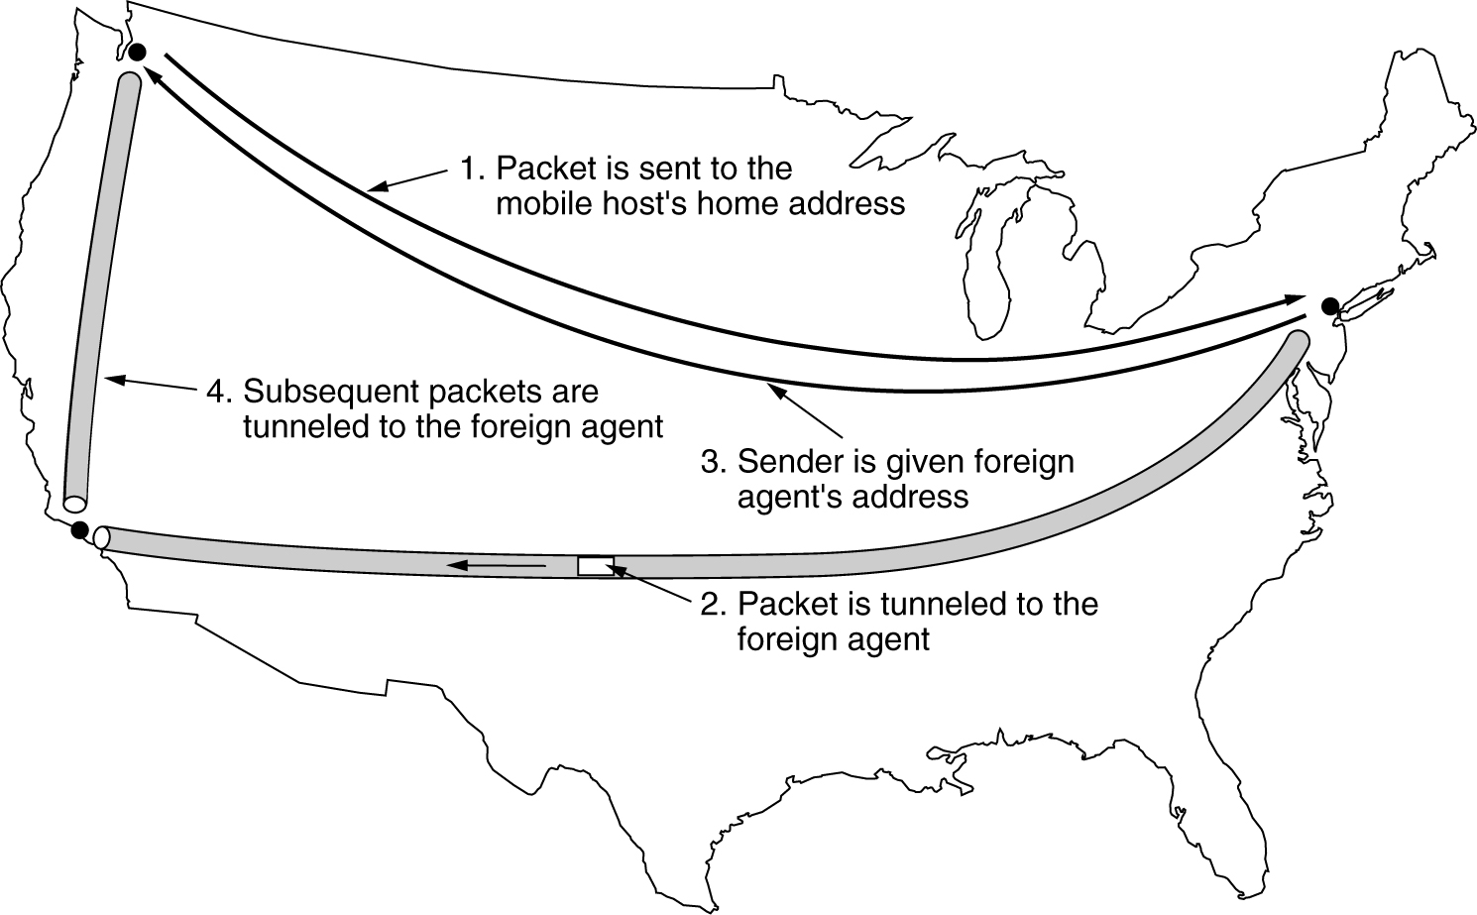
Routing Algorithms – Mobile Host
Step 5:
When the foreign agent gets the acknowledgement from the home agent, it makes an entry in its tables and informs the mobile host that it is now registered.
Packet routing for mobile users.

Slide 72
When a packet is sent to a mobile host, it is routed to the host's home LAN because that is what the address says should be done, as illustrated in step 1 of following figure.
Here the sender, in the northwest city of Seattle, wants to send a packet to a host normally across the United States in New York.
Packets sent to the mobile host on its home LAN in New York are intercepted by the home agent there.
The home agent then looks up the mobile host's new (temporary) location and finds the address of the foreign agent handling the mobile host, in Los Angeles.

Slide 73
The home agent then does two things.
First, it encapsulates the packet in the payload field of an outer packet and sends the latter to the foreign agent (step 2 in Fig.).
This mechanism is called tunneling;
After getting the encapsulated packet, the foreign agent removes the original packet from the payload field and sends it to the mobile host as a data link frame.
Second, the home agent tells the sender to henceforth send packets to the mobile host by encapsulating them in the payload of packets explicitly addressed to the foreign agent instead of just sending them to the mobile host's home address (step 3).
Subsequent packets can now be routed directly to the host via the foreign agent (step 4), bypassing the home location entirely.

Slide 74
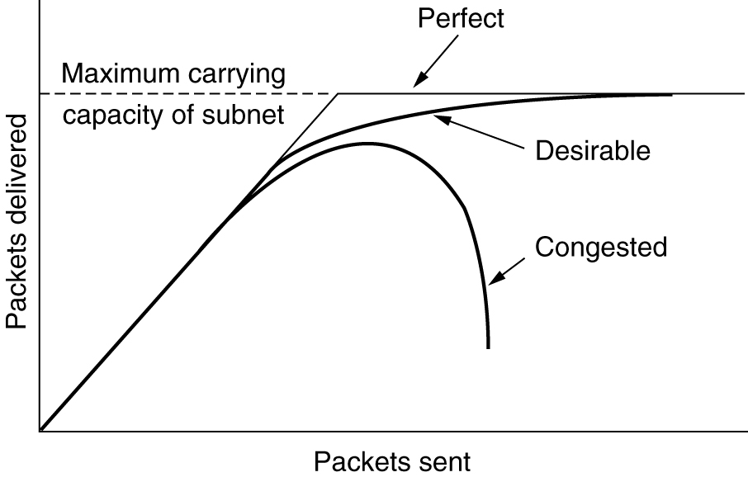
Congestion Control Algorithms
When too many packets are present in the subnet, performance degrades. This situation is called congestion
When too much traffic is offered, congestion sets in and performance degrades sharply.

Slide 75
Congestion Control Algorithms
Congestion can be brought on by several factors:
If all of a sudden, streams of packets begin arriving on three or four input lines and all need the same output line, a queue will build up.
If there is insufficient memory to hold all of them, packets will be lost.
But if routers have an infinite amount of memory, congestion gets worse because by the time packets get to the front of the queue, they have already timed out
Slow processors can also cause congestion.
If the routers' CPUs are slow at performing queuing buffers, updating tables, etc., queues can build up, even though there is excess line capacity.
low-bandwidth lines can also cause congestion.
Upgrading the lines often helps a little

Slide 76
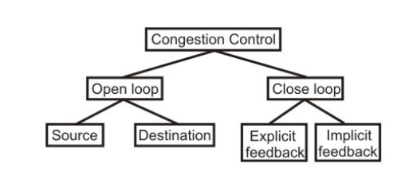
General Principles of Congestion Control
Open loop solutions attempt to solve the problem by good design, to make sure congestion does not occur in the first place.
Once the system is up and running, midcourse corrections are not made
Tools for doing open-loop control include
deciding when to accept new traffic
deciding when to discard packets
which ones to discard
making scheduling decisions at various points in the network

Slide 77
General Principles of Congestion Control
Closed loop solutions are based on the concept of a feedback loop.
This approach has three parts when applied to congestion control:
Monitor the system to detect when and where congestion occurs.
Pass this information to places where action can be taken.
Adjust system operation to correct the problem.
Variety of metrics can be used to monitor the subnet for congestion:
percentage of all packets discarded for lack of buffer space,
average queue lengths,
number of packets that time out and are retransmitted,
average packet delay, and
standard deviation of packet delay.
In all cases, rising numbers indicate growing congestion

Slide 78
General Principles of Congestion Control
Second step in the feedback loop
Router detecting the congestion has to send a packet to the traffic source or sources, announcing the problem
But these extra packets increase the load
Other approaches are also used at times to curtail down the congestion. For example, hosts or routers send out probe packets at regular intervals to explicitly ask about the congestion and source itself regulate its transmission rate, if congestion is detected in the network.
This kind of approach is a pro-active one, as source tries to get knowledge about congestion in the network and act accordingly.
Another approach may be where instead of sending information back to the source an intermediate router which detects the congestion send the information about the congestion to rest of the network, piggy backed to the outgoing packets.
This approach will in no way put an extra load on the network (by not sending any kind of special packet for feedback).
Once the congestion has been detected and this information has been passed to a place where the action needed to be done,

Slide 79
General Principles of Congestion Control
Open loop algorithms are divided into
ones that act at the source
ones that act at the destination
Closed loop algorithms are divided into
explicit feedback
implicit feedback
In explicit feedback algorithms, packets are sent back from the point of congestion to warn the source.
In implicit algorithms, the source deduces the existence of congestion by making local observations, such as the time needed for acknowledgements to come back
Ways to correct the problem caused by congestion
increase the resources or decrease the load

Slide 80
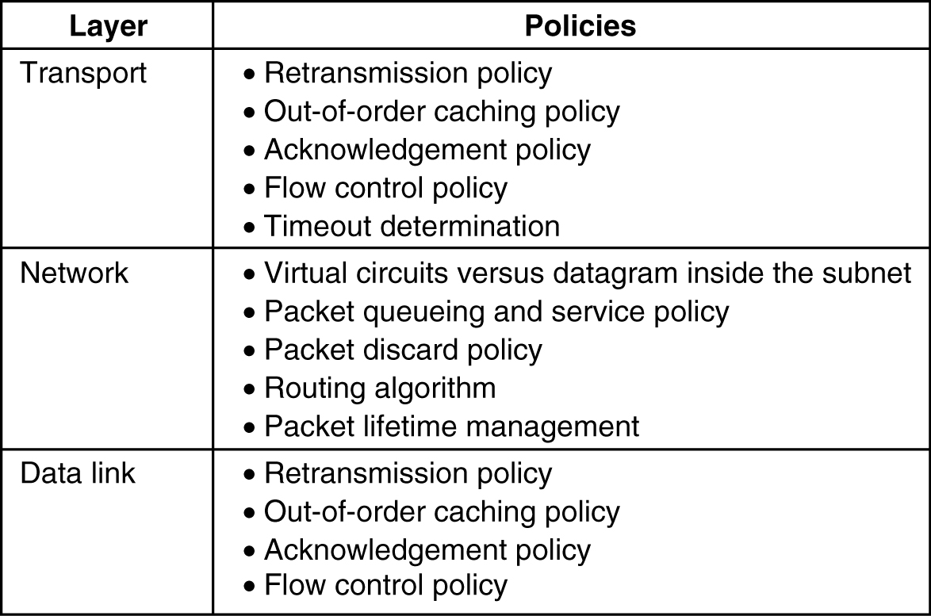
Congestion Prevention Policies
Open loop Systems are designed to minimize congestion, rather than letting it happen and reacting by using appropriate policies at various levels
5-26
Policies that affect congestion

Slide 81
Congestion Prevention Policies
Policies considered in the Data link layer
Retransmission policy:
how fast a sender times out and what it transmits upon timeout
go back n will put a heavier load on the system than selective repeat
Out-of-order caching policy:
selective repeat is clearly better than go back n
Acknowledgement policy:
Piggybacking onto reverse traffic may help
But extra timeouts and retransmissions may happen.
Flow control Policy:
a small window reduces the data rate and thus helps fight congestion

Slide 82
Congestion Prevention Policies
Policies considered in the Network layer
Choice of virtual circuits vs datagrams:
affects congestion since many congestion control algorithms work only with virtual-circuit subnets
Packet queuing and service policy:
relates to whether routers have one queue per input line, one queue per output line, or both
also relates to the order in which packets are processed (e.g., round robin or priority based)
Packet Discard policy :
Rule telling which packet is dropped when there is no space
Routing algorithm:
Good algorithm can help avoid congestion by spreading the traffic over all the lines

Slide 83
Congestion Prevention Policies
Packet lifetime management:
deals with how long a packet may live before being discarded
If it is too long, lost packets may block up the works for a long time
If it is too short, packets may sometimes time out before reaching their destination, thus inducing retransmissions
Policies considered in the Transport layer
Same issues as in data link layer plus
Timeout determination:
determining the timeout interval is harder because the transit time across the network is less predictable
If the timeout interval is too short, extra packets will be sent unnecessarily.
If it is too long, congestion will be reduced but the response time will suffer whenever a packet is lost.

Slide 84
Congestion Control in Virtual-Circuit Subnets
One technique: admission control
Idea is simple:
once congestion has been signaled, no more virtual circuits are set up until the problem has gone away.
Thus, attempts to set up new transport layer connections fail.
Alternative approach:
to allow new virtual circuits
but carefully route all new virtual circuits around problem areas
Figure is shown in the next slide

Slide 85
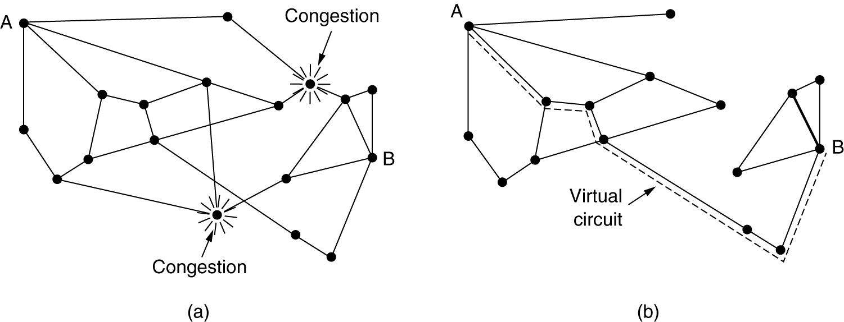
Congestion Control in Virtual-Circuit Subnets
(a) A congested subnet. (b) A redrawn subnet, eliminates congestion and a virtual circuit from A to B.

Slide 86
Congestion Control in Virtual-Circuit Subnets
Another strategy:
To negotiate an agreement between the host and subnet when a virtual circuit is set up.
This agreement normally specifies the volume and shape of the traffic, quality of service required, and other parameters.
Subnet will typically reserve resources along the path when the circuit is set up.
These resources can include table and buffer space in the routers and bandwidth on the lines.
Congestion is unlikely to occur on the new VC because all the necessary resources are guaranteed to be available.
This kind of reservation can be done all the time as standard operating procedure or only when the subnet is congested.
Disadvantage of doing it all the time is that it tends to waste resources.

Slide 87
Congestion Control in Datagram Subnets
Let us see some approaches that can be used in datagram subnets (and also in virtual-circuit subnets).
Each router can easily monitor the utilization of its output lines and other resources.
For example, it can associate with each line a real variable, u, whose value is between 0.0 and 1.0, which reflects the recent utilization of that line.
To maintain a good estimate of u, a sample of the instantaneous line utilization, f (either 0 or 1), can be made periodically and u updated according to
where the constant a determines how fast the router forgets recent history

Slide 88
Congestion Control in Datagram Subnets
Whenever u moves above the threshold, the output line enters a ''warning'' state.
Each newly-arriving packet is checked to see if its output line is in warning state.
If it is, some action is taken.
The action taken can be one of several alternatives as discussed below
The Warning Bit
Choke Packets
Hop-by-Hop Choke Packets

Slide 89
Congestion Control in Datagram Subnets
The Warning Bit
Old DECNET architecture & frame relay signaled the warning state by setting a special bit in the packet's header
When the packet arrived at its destination, the transport entity copied the bit into the next acknowledgement sent back to the source
The source then cut back on traffic
As long as the router was in the warning state, it continued to set the warning bit, which meant that the source continued to get acknowledgements with it set.

Slide 90
The source monitored the fraction of acknowledgements with the bit set and adjusted its transmission rate accordingly.
As long as the warning bits continued to flow in, the source continued to decrease its transmission rate.
When they slowed to a trickle, it increases its transmission rate.
Note that since every router along the path could set the warning bit, traffic is increased only when no router was in trouble.

Slide 91
Congestion Control in Datagram Subnets
Choke Packets
Previous congestion control algorithm uses a roundabout means to tell the source to slow down. Why not just tell it directly?
In this approach, the router sends a choke packet back to the source host, giving it the destination found in the packet.
original packet is tagged (a header bit is turned on) so that it will not generate any more choke packets farther along the path and is then forwarded in the usual way.

Slide 92
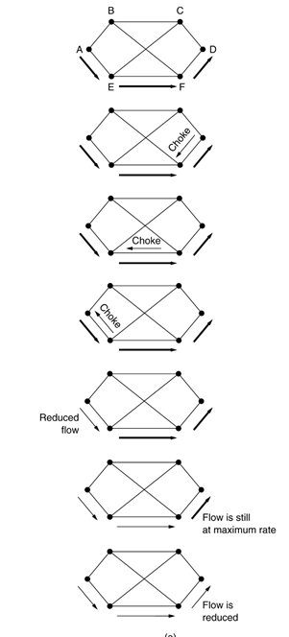
When the source host gets the choke packet, it is required to reduce the traffic sent to the specified destination by X percent.
Since other packets aimed at the same destination are probably already under way and will generate yet more choke packets,
the host should ignore choke packets referring to that destination for a fixed time interval.
After that period has expired, the host listens for more choke packets for another interval.
If one arrives, the line is still congested, so the host reduces the flow still more and begins ignoring choke packets again.
If no choke packets arrive during the listening period, the host may increase the flow again.

Slide 93
Congestion Control in Datagram Subnets
Hosts can reduce traffic by adjusting their policy parameters, for example, their window size.
Typically, the first choke packet causes the data rate to be reduced to 0.50 of its previous rate,
Next one causes a reduction to 0.25, and so on.
Increases are done in smaller increments to prevent congestion from reoccurring quickly.
Several variations on this congestion control algorithm
routers can maintain several thresholds.
Depending on which threshold has been crossed, the choke packet can contain a mild warning, a stern warning, or an ultimatum.
to use queue lengths or buffer utilization instead of line utilization as the trigger signal.

Slide 94
Congestion Control in Datagram Subnets
Hop-by-Hop Choke Packets
At high speeds or over long distances, sending a choke packet to the source hosts does not work well because the reaction is so slow.
Refer to figure (a) of next slide
Alternative approach is to have the choke packet take effect at every hop it passes through
Refer to figure a of next slide
as soon as the choke packet reaches F, F is required to reduce the flow to D.
Doing so will require F to devote more buffers to the flow, since the source is still sending away at full blast
This is done till the choke packet reaches the source
net effect is to provide quick relief at the point of congestion at the price of using up more buffers upstream

Slide 95
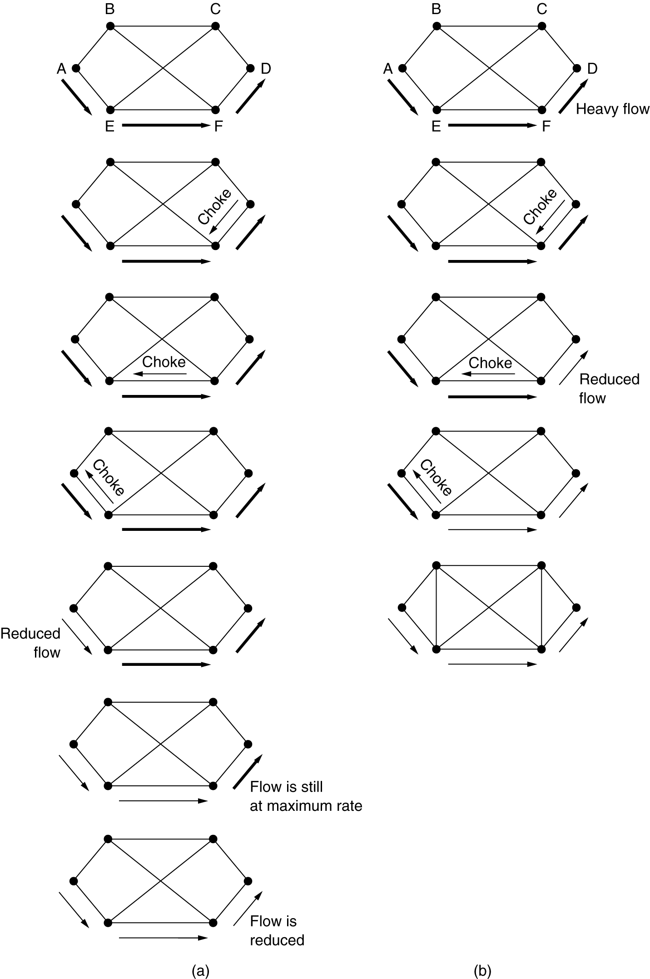
Hop-by-Hop Choke Packets
(a) A choke packet that affects only the source.
(b) A choke packet that affects each hop it passes through.

Slide 96
Load Shedding
Load shedding is a fancy way of saying that when routers are being flooded by packets that they cannot handle, they just throw them away
Methods for dropping:
can just pick packets at random to drop
discard may depend on the applications running
For file transfer, an old packet is worth more than a new one
old is better than new is often called wine
For multimedia, a new packet is more important than an old one.
new is better than old is often called milk

Slide 97
Load Shedding
To implement an intelligent discard policy, applications must mark their packets in priority classes to indicate how important they are.
Senders might be allowed to send high-priority packets under conditions of light load
but as the load increased they would be discarded, thus encouraging the users to stop sending them
Another option is to allow hosts to exceed the limits specified in the agreement negotiated when the virtual circuit was set up (e.g., use a higher bandwidth than allowed)
but subject to the condition that all excess traffic be marked as low priority.

Slide 98
Load Shedding
Random Early Detection
Dealing with congestion after it is first detected is more effective than letting it gum up the works and then trying to deal with it.
Idea is to discarding packets before all the buffer space is really exhausted
To determine when to start discarding, routers maintain a running average of their queue lengths.
When the average queue length on some line exceeds a threshold, the line is said to be congested and action is taken.

Slide 99
Jitter Control
For applications such as audio and video streaming, it does not matter much if the packets take 20 msec or 30 msec to be delivered, as long as the transit time is constant.
The variation (i.e., standard deviation) in the packet arrival times is called jitter.
High jitter, for example, having some packets taking 20 msec and others taking 30 msec to arrive will give an uneven quality to the sound or movie.

Slide 100
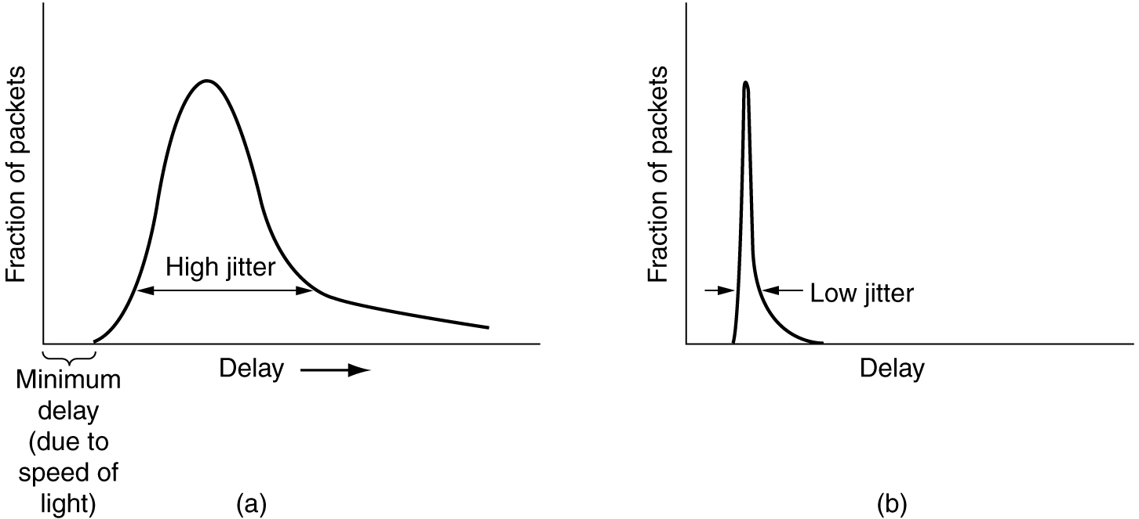
Jitter Control
(a) High jitter. (b) Low jitter.

Slide 101
Jitter Control
The jitter can be controlled by computing the expected transit time for each hop along the path.
When a packet arrives at a router, the router checks to see how much the packet is behind or ahead of its schedule.
This information is stored in the packet and updated at each hop.
If the packet is ahead of schedule, it is held just long enough to get it back on schedule.
If it is behind schedule, the router tries to send it out quickly.
both cases reducing the amount of jitter

Slide 102
In applications such as video on demand, jitter can be eliminated by buffering at the receiver and then fetching data for display from the buffer instead of from the network in real time.
In real time applications like Internet telephony & videoconferencing, the delay inherent in buffering is not acceptable.

Slide 103
Quality of Service
Four issues must be addressed to ensure quality of service.
What applications need from the network?
How to regulate the traffic that enters the network.
How to reserve resources at routers to guarantee performance.
Whether the network can safely accept more traffic.

Slide 104
Application Requirements
A stream of packets from a source to destination is called a flow.
In a connection oriented network all the packets belonging to a flow allow the same route, in connectionless they may follow different route.
The needs of each flow can be characterized by four primary parameters; reliability, delay, jitter and bandwidth.
Together these determine the QOS.
The variation (i.e., standard deviation) in the delay or packet arrival times is called jitter.

Slide 105
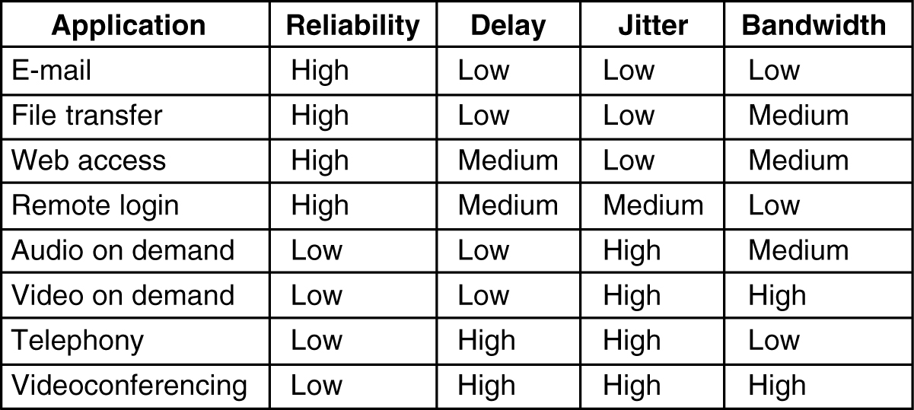
How stringent the quality-of-service requirements are.

Slide 106
Techniques for Achieving Good Quality of Service
Overprovisioning
Buffering
Traffic Shaping
Packet Scheduling

Slide 107
Overprovisioning
An easy solution is to provide so much router capacity, buffer space, and bandwidth that the packets just fly through easily.
The trouble with this solution is that it is expensive.
As time goes on and designers have a better idea of how much is enough, this technique may even become practical.

Slide 108
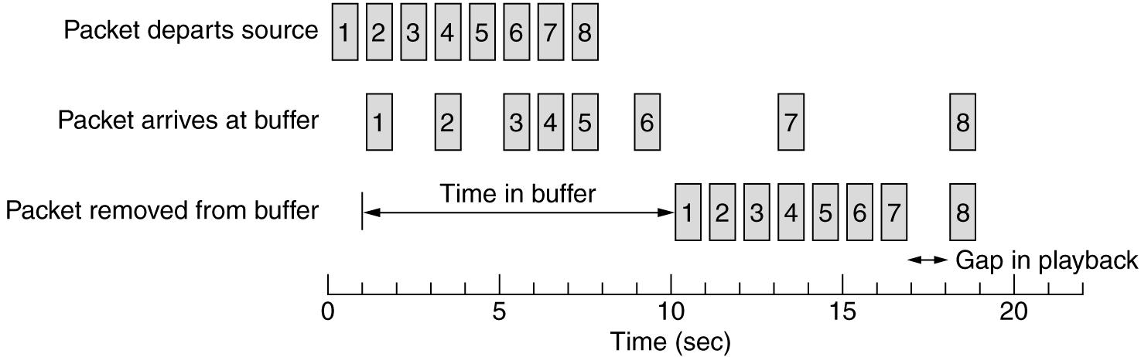
Buffering
Flows can be buffered on the receiving side before being delivered.
Buffering them does not affect the reliability or bandwidth, and increases the delay, but it smooths out the jitter.
For audio and video on demand, jitter is the main problem, so this technique helps a lot.
Smoothing the output stream by buffering packets.

Slide 109
Traffic Shaping
One of the main causes of congestion is that traffic is often bursty.
Traffic shaping is about regulating the average rate (and burstiness) of data transmission.
Monitoring a traffic flow is called traffic policing.
Agreeing to a traffic shape and policing it afterward are easier with virtual-circuit subnets than with datagram subnets.
When a connection is set up, the user and the subnet(i.e., the customer and the carrier) agree on a certain traffic pattern (i.e., shape) for that circuit. Sometimes this is called a service level agreement.

Slide 110
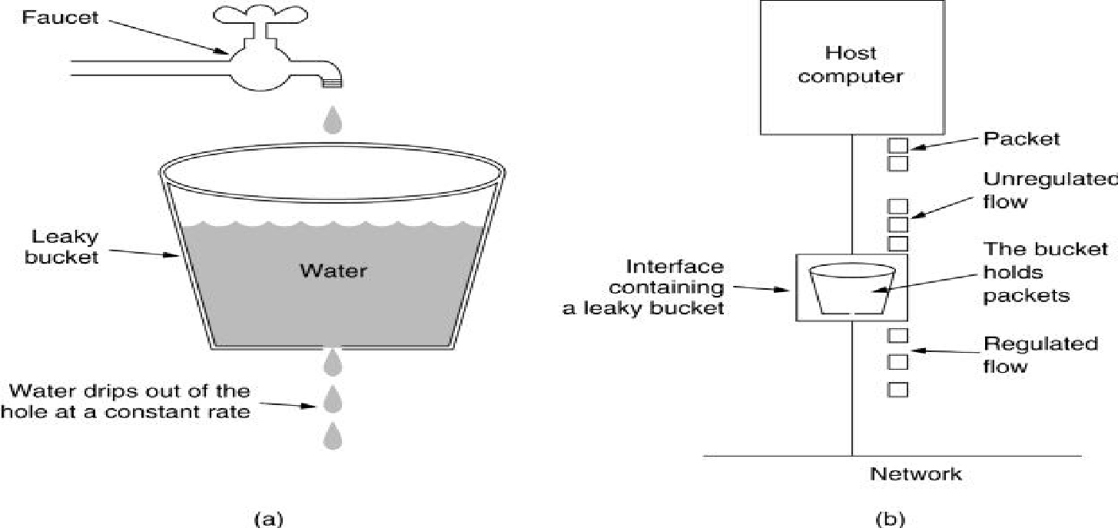
The Leaky Bucket Algorithm
Imagine a bucket with a small hole in the bottom, as illustrated in Fig.4-4(a).
No matter the rate at which water enters the bucket, the outflow is at a constant rate when there is any water in the bucket and zero when the bucket is empty.
Also, once the bucket is full, any additional water entering it spills over the sides and is lost
In practice the bucket is a finite queue that outputs at a finite rate.
Figure 4-4. (a) A leaky bucket with water. (b) A leaky bucket with packets.

Slide 111
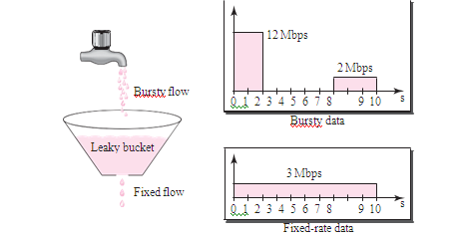
In the ﬁgure, we assume that the network has committed a bandwidth of 3 Mbps for a host.
The use of the leaky bucket shapes the input traffic to make it conform to this commitment.
In Figure the host sends a burst of data at a rate of 12 Mbps for 2 s, for a total of 24 Mbits of data.
The host is silent for 5 s and then sends data at a rate of 2 Mbps for 3 s, for a total of 6 Mbits of data.
In all, the host has sent 30 Mbits of data in 10 s.
The leaky bucket smooths the trafﬁc by sending out data at a rate of 3 Mbps during the same 10 s.

Slide 112
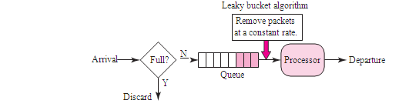
The Leaky Bucket Algorithm
A leaky bucket algorithm shapes bursty trafﬁc into ﬁxed-rate trafﬁc by averaging the data rate.
It may drop the packets if the bucket is full.

Slide 113
This can be implemented as follows.
On a sender, a time-dependent queue ensures that an equal amount of data units is send per time interval.
On the one hand, data can be put fast into the queue until it is full.
On the other hand, data always leave the queue at the same rate.
If the queue is full no more packets can be stored in it and packet loss occurs.
If the queue is empty, no data leaves the queue.
The Leaky Bucket algorithm can be implemented for packets or a constant amount of bytes, send within each time interval.

Slide 114
Conceptually each network interface contains a leaky bucket. And the following steps are performed:
When the host has to send a packet, the packet is thrown into the bucket.
The bucket leaks at a constant rate, meaning the network interface transmits packets at a constant rate.
Burst traffic is converted to a uniform traffic by the leaky bucket.

Slide 115
The Token Bucket Algorithm
The leaky bucket algorithm enforces a rigid output pattern at the average rate, no matter how bursty the traffic is.
For many applications, it is better to allow the output to speed up somewhat when large bursts arrive.
One such algorithm is the token bucket algorithm.
In this algorithm, the leaky bucket holds tokens, generated by a clock at the rate of one token every ΔT sec.
In Fig. 4-5(a) a bucket is holding three tokens, with five packets waiting to be transmitted.
For a packet to be transmitted, it must capture and destroy one token.
In Fig. 4-5(b) three of the five packets have gotten through, but the other two are stuck waiting for two more tokens to be generated.

Slide 116
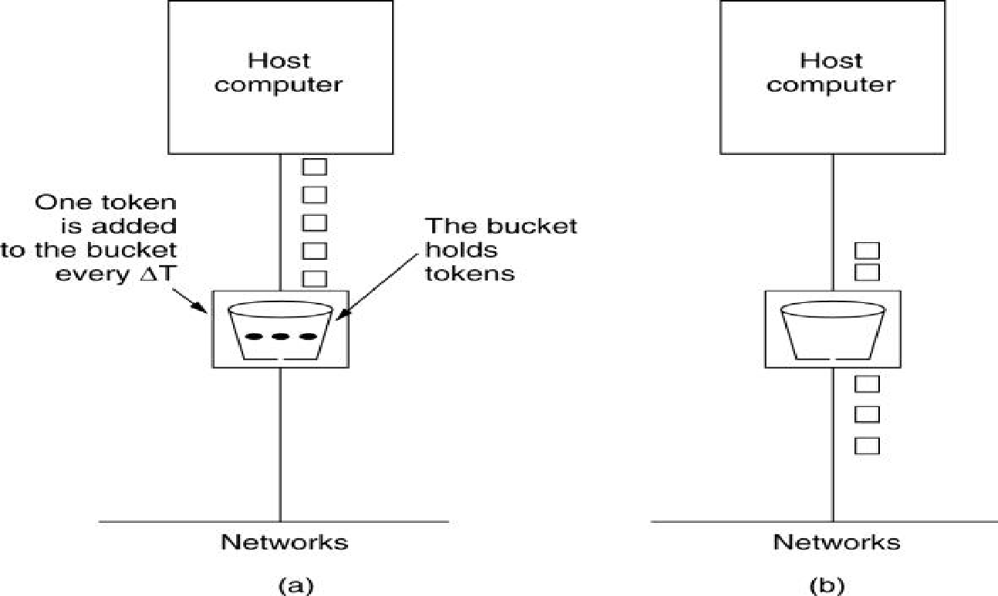
Figure 4-5. The token bucket algorithm. (a) Before. (b) After.

Slide 117
Tutorial
A computer on a 6-Mbps network is regulated by a token bucket. The token bucket is filled at a rate of 1 Mbps. It is initially filled to capacity with 8 megabits. How long can the computer transmit at the full 6 Mbps?

Slide 118
Max transmission rate, M=6 Mbps Token arrival rate, R=1 Mbps Capacity of token bucket, C=8 Mb Time duration in which a computer will transmit in full speed=C/M−R
=8/(6−1)
=8/5
=1.6 sec

Slide 119
Packet Scheduling
Packets from different flows arrive at a switch or router for processing.
A good scheduling technique treats the different flows in a fair and appropriate manner.
Several scheduling techniques are designed to improve the quality of service.
Three of them here:
1. FIFO queuing,
2. priority queuing,
3. and weighted fair queuing.

Slide 120
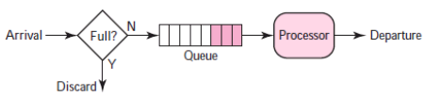
Packet Scheduling
FIFO Queuing:
In first-in, first-out (FIFO) queuing, packets wait in a buffer (queue) until the node (router or switch) is ready to process them.
If the average arrival rate is higher than the average processing rate, the queue will fill up and new packets will be discarded.
Fig: FIFO queue

Slide 121
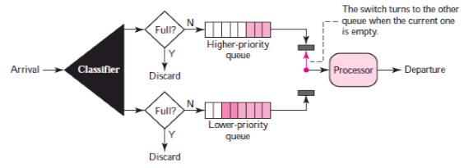
Packet Scheduling
2) Priority Queuing:
In priority queuing, packets are first assigned to a priority class.
Each priority class has its own queue.
The packets in the highest-priority queue are processed first.
Packets in the lowest-priority queue are processed last.
Note that the system does not stop serving a queue until it is empty.
Fig: Priority queuing

Slide 122
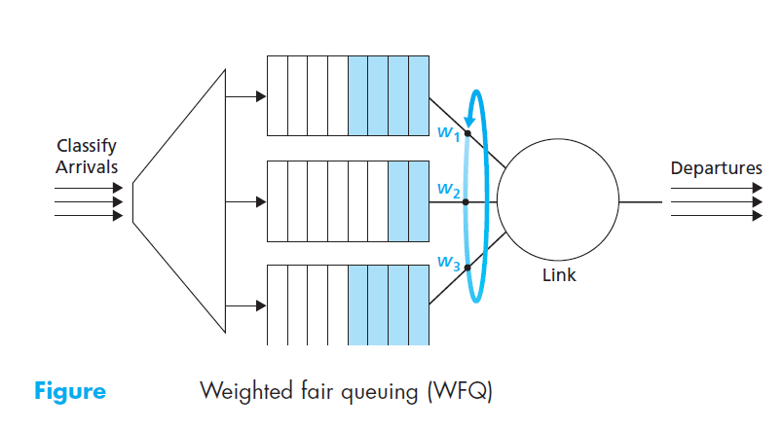
Packet Scheduling
3) Weighted Fair Queuing:
A better scheduling method is weighted fair queuing.
In this technique, the packets are still assigned to different classes and admitted to different queues.
The queues, however, are weighted based on the priority of the queues;
higher priority means a higher weight.
The system processes packets in each queue in a round-robin fashion with the number of packets selected from each queue based on the corresponding weight.

